Slide 1

A Dual Analysis of NYC Business Licenses
A Machine-Learning Approach
Team #8 | CS667 – Practical Data Science
Members :- Ronak Pipaliya | Sajan Shergil |
Darpan Gorasiya
Instructor: Dr. Krishna Bathula

Slide 2
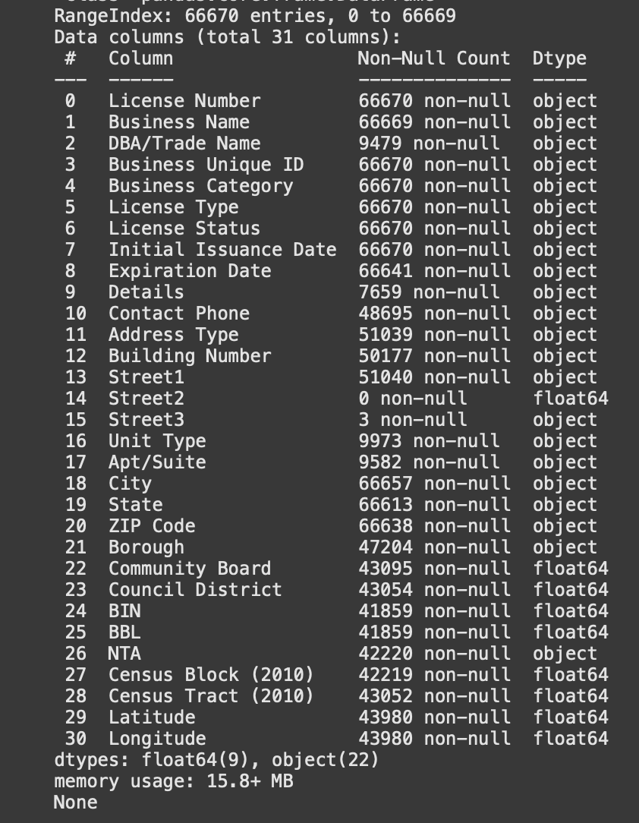
Project Overview
Objective:
1. Estimate missing geolocations (Regression)
2. Predict license renewal / lapse (Classification)
Dataset: ≈ 66K NYC Business License Records
Tools: Python (Pandas, Scikit-learn, Matplotlib), SMOTE
Approach: Ensemble ML methods (Random Forest, Gradient Boosting)

Slide 3
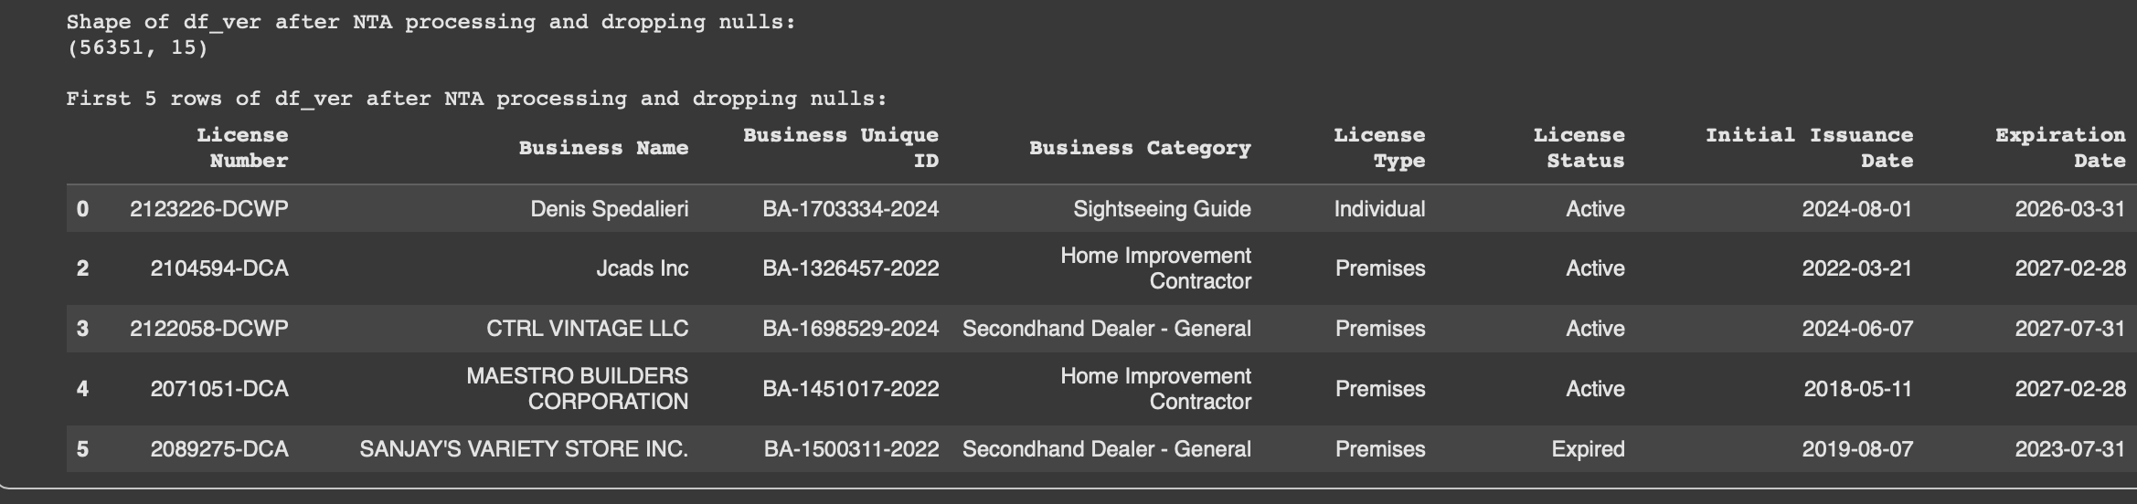
Data Understanding & Preparation
• Reduced columns: 31 → 15 key features
• Dropped: >60% missing (DBA/Trade Name, Street2, Apt/Suite)
• Imputed Borough & NTA using ZIP mapping
• Removed invalid License Duration time (Expiration < Issuance)
• Filtered ‘Outside NYC’ entries
→ Final dataset: 56,321 records

Slide 4
Feature Engineering & Preprocessing
Derived feature: License_Duration = Expiration Date − Issuance Date
One-Hot Encoded categorical features (Borough, License Status)
StandardScaler for numeric fields
Train/Test split 70/20/10, stratified
SMOTE oversampling for class imbalance

Slide 5
Regression Task Setup
Goal: Predict missing Latitude & Longitude
Models Evaluated
Ridge Regression
Decision Tree
KNN
Random Forest
Gradient Boosting
Metrics: RMSE, MAE, R²

Slide 6
Regression Results
📊 Model Performance (Test Set)
Model Performance:
Random Forest RMSE=0.03717, MAE=0.02826, R²=0.8115
Decision Tree RMSE=0.03719, MAE=0.02827, R²=0.8113
Gradient Boosting RMSE=0.03719, MAE=0.02838, R²=0.8113
Ridge RMSE=0.03820, MAE=0.02996, R²=0.8007
KNN RMSE=0.03905, MAE=0.02976, R²=0.7918
Best: Random Forest (≈3.3 km mean spatial error)
Model | RMSE | MAE | R²
Random Forest | 0.03717 | 0.02826 | 0.8115
Decision Tree | 0.03719 | 0.02827 | 0.8113
Gradient Boosting | 0.03719 | 0.02838 | 0.8113
Ridge Regression | 0.03820 | 0.02996 | 0.8007
KNN Regressor | 0.03905 | 0.02976 | 0.7918

Slide 7
Regression Model Summary :- Predicting Missing Coordinates
⚙️ Approach
Replaced outliers beyond NYC bounds (≈40.45–40.95 °N, −74.25–−73.65 °W) with NaN
Hierarchical imputation for missing coordinates: → Median by (ZIP, Borough, Business Category) → Fallback to (Borough, Category) medians
Used low-cardinality categorical vars (min_frequency=0.02)
Encoded via One-Hot Encoding (OHE) to avoid feature explosion

Slide 8
🔍 Interpretation & Insights:-
Random Forest slightly best (RMSE≈0.037°, ≈4 km spatial deviation)
Decision Tree & GB similar → stable spatial pattern
Ridge = strong linear baseline; KNN slightly underperforms
ZIP + Borough + Business Category strongly predict location
Multi-output regression captures spatial correlation effectively
🏁 Conclusion:-
✅ Top Models for Deployment:
🥇 Random Forest Regressor — best accuracy, robust, interpretable
🥈 Gradient Boosting Regressor — similar accuracy, finer calibration
→ Enables precise geolocation inference for NYC business licenses

Slide 9
Classification Task Setup
Goal: Predict whether a license will Lapse (1) or Remain Active (0)
Features: License_Duration, Borough, Business Category, NTA, License Type
Models: Gradient Boosting, Random Forest
Metrics: ROC-AUC, PR-AUC, Balanced Accuracy

Slide 10
Classification Results
Metric | Gradient Boosting | Random Forest
ROC-AUC | 0.7316 | 0.7359
PR-AUC | 0.6178 | 0.6293
Balanced Accuracy | 0.6130 | 0.6650
ΔROC (Overfit) | 0.018 | 0.110
CV ROC-AUC | 0.739 | 0.738
📊 Performance (Test + CV)
Gradient Boosting vs Random Forest:
ROC-AUC: 0.7316 | 0.7359
PR-AUC: 0.6178 | 0.6293
Balanced Accuracy: 0.6130 | 0.6650
5-Fold CV ROC-AUC: 0.739 | 0.738
Both consistent (AUC≈0.73)
GB → better calibration; RF → better recall

Slide 11
Model Interpretation & Insights
• License_Duration strongest predictor of renewal
• Borough & Business Category influence lapse
• Minimal overfitting (ΔROC < 0.1)
• Random Forest best overall performer

Slide 12
Technical Takeaways
Aspect | Technique | Outcome
Data Imputation | ZIP→Borough/NTA | Restored >95% records
Imbalance Handling | SMOTE | +25% minority recall
Encoding | OHE + Scaling | Enabled tree learning
Validation | 5-Fold CV | Stable AUC≈0.73
Performance | RF>GB | Strong generalization

Slide 13
Future Enhancements
• Introduce XGBoost/LightGBM
• Add socioeconomic predictors (income, density)
• Deploy as REST API for DCWP integration
• Integrate into GIS dashboards

Slide 14
Conclusion
• Regression: Predicts coordinates within ~3.3 km
• Classification: Forecasts license renewal with AUC≈0.73
• Ensemble methods effective & interpretable
• Supports data-driven DCWP decision-making

